Slide 1
System Testing cont…
Dr. Durga Prasad Mohapatra
Professor, Dept. of CSE,
NIT Rourkela
Notes:
1

Slide 2
SECURITY TESTING

Slide 3
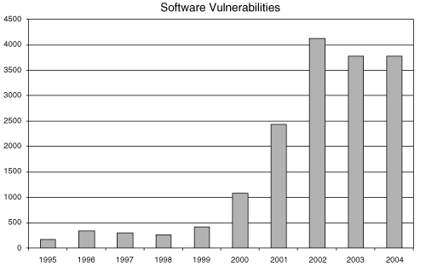
Software Problem
# vulnerabilities Reported by CERT/CC
Notes:
3

Slide 4
More than half of the vulnerabilities are due to buffer overruns.
Others such as race conditions, design flaws are equally prevalent.

Slide 5
Software security
It is about
  Understanding software-induced security risks and how to manage them
  Leveraging software engineering practice,
  Thinking security early in the software lifecycle
  Knowing and understanding common problems
  Designing for security
  Subjecting all software artifacts to thorough objective risk analyses and testing
It is a knowledge intensive field
Notes:
5

Slide 6
Software Security
Renewed interest
  “idea of engineering software so that it continues to function correctly under malicious attack”
  Existing software is riddled with design flaws and implementation bugs
  “any program, no matter how innocuous it seems, can harbor security holes”
Notes:
6

Slide 7
Security Testing
Security is a protection system that is needed to assure the customers that their data will be protected.
  For example, if the internet users feel that their personal data/ information is not secure, the system loses its accountability.
Security may include controlling access to data, encrypting data in communication, ensuring secrecy of stored data, auditing security events, etc.
  Security breaches can result in loss of information, privacy violations, denial of service (DOS), etc.

Slide 8
Types of Security Requirements
While performing security testing, the following security requirements must be considered:
  Security requirements should be associated with each functional requirement.
    Each functional requirement, most likely, has a specific set of related security issues to be addressed in the software implementation.
    For example, the log on requirement in a client server system must specify the number of retries allowed, the action to be taken if the log-on fails, and so on.

Slide 9
Example of Security Concerns
In addition to the security concerns that are directly related to particular requirements, a software project has security issues that are global in nature, and hence related to the application’s architecture and overall implementation.
    For example, a web application may have a global requirement that all private customer data of any kind is stored in encrypted form in the database.
    In another example, a system wide security requirement is to use SSL to encrypt the data sent between the client browser and the web server - the testing team should verify the correctness of SSL.

Slide 10
Security Concerns cont…
The problem with security testing is that security-related bugs are not as obvious as other types of bugs.
It may be possible that the security system has failed and caused the loss of information without the knowledge of loss.
Thus, the tester should perform security testing with the goals to identify the bugs that are very difficult to identify.

Slide 11
What is a vulnerability?
A vulnerability is a hole or a weakness in the application, which can be a design flaw or an implementation bug, that allows an attacker to exploit / cause harm to the stakeholders of an application.
Stakeholders include the application owner, application users, and other entities that rely on the application.

Slide 12
OWASP Top 10 Vulnerabilities
( Released in 2025 )
A01:2025 Broken Access Control:
It is a web security vulnerability that arises when an application fails to enforce restrictions on user permissions, allowing attackers to access data or perform actions beyond their authorized rights.
A02:2025 Security Misconfiguration:
Security misconfiguration is when a system, application, or cloud service is set up incorrectly from a security perspective, creating vulnerabilities.
A03:2025 Software Supply Chain Failures :
Software supply chain failures are breakdowns or other compromises in the process of building, distributing, or updating software. They are often caused by vulnerabilities or malicious changes in third-party code, tools, or other dependencies that the system relies on.
A04:2025 Cryptographic Failures:
Cryptographic Failures refer to weaknesses or errors in the implementation, configuration, or use of cryptographic systems, leading to potential data breaches, loss of integrity, or unauthorized access.

Slide 13
A05:2025 Injection :
An injection vulnerability is an application flaw that allows untrusted user input to be sent to an interpreter (e.g. a browser, database, the command line) and causes the interpreter to execute parts of that input as commands.
A06:2025 Insecure Design :
Insecure design is a broad category representing different weaknesses, expressed as “missing or ineffective control design.”
A07:2025 Authentication Failures:
When an attacker is able to trick a system into recognizing an invalid or incorrect user as legitimate, this vulnerability is present.
A08:2025 Software or Data Integrity Failures:
Software and data integrity failures relate to code and infrastructure that does not protect against invalid or untrusted code or data being treated as trusted and valid. An example of this is where an application relies upon plugins, libraries, or modules from untrusted sources, repositories, and content delivery networks (CDNs). An insecure CI/CD pipeline without consuming and providing software integrity checks can introduce the potential for unauthorized access, insecure or malicious code, or system compromise.
A09:2025 Security Logging & Alerting Failures:
Without logging and monitoring, attacks and breaches cannot be detected, and without alerting it is very difficult to respond quickly and effectively during a security incident.
A10:2025 Mishandling of Exceptional Conditions:
Mishandling exceptional conditions in software happens when programs fail to prevent, detect, and respond to unusual and unpredictable situations, which leads to crashes, unexpected behavior, and sometimes vulnerabilities.

Slide 14
Software Vulnerability
  Vulnerability is an error that an attacker can exploit.
  Security vulnerabilities are of the following types:
    Bugs at the implementation level, such as local implementation errors or inter-procedural interface errors.
    Design level mistakes.
  Design level vulnerabilities are the hardest defect category to handle, but they are also the most prevalent and critical.

Slide 15
Software Vulnerability cont…
Unfortunately, ascertaining whether a program has design level vulnerabilities requires great expertise
  which makes finding not only difficult but particularly hard to automate.
Examples: problem in error handling, unprotected data channels, incorrect or missing access control mechanisms, and timing errors especially in multithreaded systems.

Slide 16
What is zero-day vulnerability?
A zero-day vulnerability is a software security flaw unknown to the vendor, meaning there's "zero days" for them to fix it, allowing attackers to exploit it before a patch exists, creating a critical window for attacks, data theft, or system compromise, as defenses aren't ready. Attackers discover the flaw, create an exploit (malicious code) to use it, and launch attacks before developers can release a fix, making these threats highly dangerous.
Man-in-the-Middle Attack:
A man-in-the-middle (MitM) attack is a form of cyberattack in which criminals exploiting weak web-based protocols insert themselves between entities in a communication channel to steal data.
None of the parties sending email, texting, or chatting on a video call are aware that an attacker has inserted their presence into the conversation and that the attacker is stealing their data.
While most cyberattacks are silent and carried out without the victims' knowledge, some MitM attacks are the opposite. They might include a bot generating believable text messages, impersonating a person's voice on a call, or spoofing an entire communications system to scrape data the attacker thinks is important from participants' devices.

Slide 17
How to Perform Security Testing
  Testers must use a risk based approach, grounded in both the system’s architectural reality and the attacker’s mindset,
    to gauge software security adequately.
  By identifying risks and potential loss associated with those risks in the system and creating tests driven by those risks
    The tester can focus on areas of code in which an attack is likely to succeed.
  Therefore, risk analysis can help in identifying potential security problems.
    Once identified and ranked, can help in security testing.

Slide 18
Risk Management
Risk management and security testing
  Software security practitioners perform many different tasks to manage software risks, including:
    Creating security abuse/misuse cases
    Listing normative security requirements
    Performing architectural risk analysis
    Building risk based security test plans
    Wielding static analysis tools
    Performing security tests.

Slide 19
Risk Management cont…
Three tasks, i.e. architectural risk analysis, risk-based security test planning, and security testing, are closely linked because a critical aspect of security testing relies on probing security risks.
Based on design-level risk analysis and ranking of security related risks, security test plans are prepared which guide the security testing.

Slide 20
Risk Management cont…
Thus, security testing must necessarily involve two diverse approaches:
  Testing security mechanisms to ensure that their functionality is properly implemented.
  Performing-risk based security testing motivated by understanding and simulating the attacker’s approach.

Slide 21
Elements of Security Testing
  Authentication
    To establish the validity of a transmission, message, or originator
  Authorization
    It is the process of determining that a requester is allowed to receive a service or perform an operation.
  Availability
    It assures that the information and communication services will be ready for use when expected.
  Non-repudiation
    A measure intended to prevent the later denial that an action happened, or a communication took place, etc.
21

Slide 22
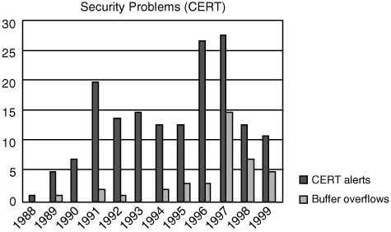
Bug
  An implementation level software problem
Flaw
  A problem at a deeper level
Bugs + Flaws
  leads to Risk
Security problems in software
Notes:
22

Slide 23

Solution …
Three pillars of security
Notes:
23

Slide 24
Pillar I:
Applied Risk Management
Architectural risk analysis
  Sometimes called threat modeling or security design analysis
  Is a best practice and is a touchpoint
Risk management framework
  Considers risk analysis and mitigation as a full life cycle activity
Notes:
24

Slide 25
Pillar II:
Software Security Touchpoints
“Software security is not security software”
  Software security
    is system-wide issues (security mechanisms and design security)
    Emergent property
Touchpoints in order of effectiveness (based on experience)
  Code review (bugs)
  Architectural risk analysis (flaws)
    These two can be swapped
  Penetration testing
  Risk-based security tests
  Abuse cases
  Security requirements
  Security operations
Notes:
25

Slide 26
Pillar II: (contd.)
Many organization
  Penetration first
    Is a reactive approach
Code Review and Architecture Risk Analysis can be switched however skipping one solves only half of the problem
Big organizations may adopt these touchpoints simultaneously
Notes:
26

Slide 27
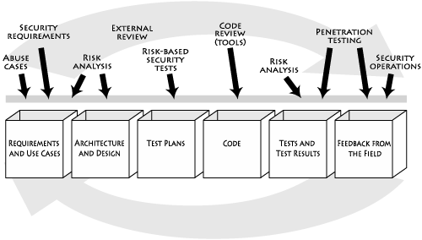
Pillar II: (contd.)
Software security best practices applied to various software artifacts
Notes:
27

Slide 28
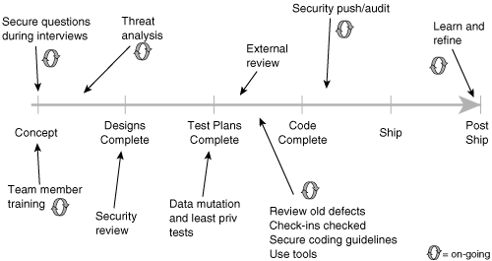
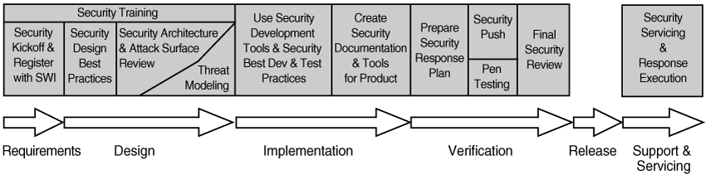
Pillar II: (contd.)
Microsoft’s move ...
Notes:
28

Slide 29
Pillar III:
Knowledge
Involves
  Gathering, encapsulating, and sharing security knowledge
Software security knowledge catalogs
  Principles
  Guidelines
  Rules
  Vulnerabilities
  Exploits
  Attack patterns
  Historical risks
  Can be put into three categories
Prescriptive knowledge
Diagnostic knowledge
Historical knowledge
Notes:
29

Slide 30
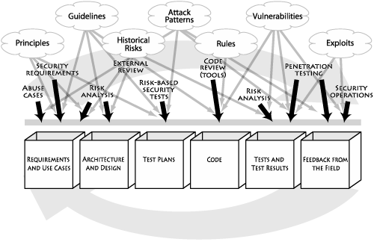
Pillar III: Knowledge catalogs to s/w artifacts
Notes:
30

Slide 31
Risk management framework:
Five Stages
RMF occurs in parallel with SDLC activities
Measurement and reporting
Understand
the Business
context
Identify
the Business
and Technical
Risk
Synthesize and
Rank the Risks
Define the Risk
Mitigation
Strategy
1
2
3
4
Artifact Analysis
Business
Context
Carry out fixes
And validate
5
Notes:
31

Slide 32
Stage 1:
Understand Business Context
Risk management
  Occurs in a business context
  Affected by business motivation
Key activity of an analyst
  Extract and describe business goals – clearly
    Increasing revenue; reducing dev cost; meeting SLAs; generating high return on investment (ROI)
  Set priorities
  Understand circumstances
Notes:
32

Slide 33
Stage 2: Identify the business & technical risks
Business risks have several impacts
  Direct financial loss; loss of reputation; violation of customer or regulatory requirements; increase in development cost
Severity of risks
  Should be captured in financial or project management terms
Key is –
  tie technical risks to business context
Notes:
33

Slide 34
Stage 3: Synthesize and rank the risks
Prioritize the risks alongside the business goals
Assign risks appropriate weights for resolution
Risk metrics
  Risk likelihood
  Risk impact
  Number of risks mitigated over time
Notes:
34

Slide 35
Stage 4: Risk Mitigation Strategy
Develop a coherent strategy
  For mitigating risks
  In cost effective manner; account for
      Cost Implementation time
      Completeness Impact
      Likelihood of success
A mitigation strategy should
  Be developed within the business context
  Be based on what the organization can afford, integrate and understand
  Must directly identify validation techniques
Notes:
35

Slide 36
Stage 5: Carry out Fixes and Validate
Execute the chosen mitigation strategy
    Rectify the artifacts
  Measure completeness
  Estimate
    Progress, residual risks
Validate that risks have been mitigated
  Testing can be used to demonstrate
  Develop confidence that unacceptable risk does not remain
Notes:
36

Slide 37
Risk Mitigation Framework - A Multi-loop
Risk management is a continuous process
  Five stages may need to be applied many times
  Ordering may be interleaved in different ways
    Risk can emerge at any time in SDLC
      One way – apply in each phase of SDLC
    Risk can be found between stages
Level of application
  Primary – project level
    Each stage must capture complete project
  SDLC phase level
  Artifact level
It is important to know that Risk Mitigation is
  Cumulative
  At times arbitrary and difficult to predict
Notes:
37

Slide 38
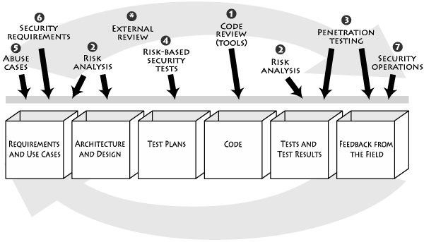
Seven Touchpoints
Notes:
38

Slide 39
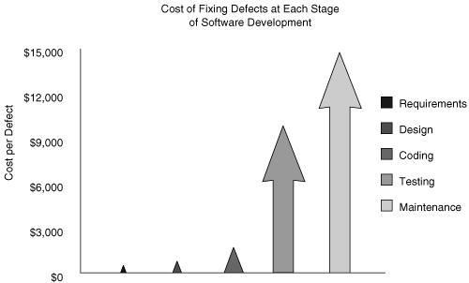
Cost of fixing defect at each stage
Notes:
39

Slide 40
Architectural risk analysis
Design flaws
  about 50% of security problem
  Can’t be found by looking at code
    A higher level of understanding required
Risk analysis
  Track risk over time
  Quantify impact
  Link system-level concerns to probability and impact measures
  Fits with the RMF
Notes:
40

Slide 41
ARA within RMF
Identify
the Business
Risk
Measurement and reporting
2
Technical
expertise
Artifact Analysis
Understand
the Business
context
Synthesize and
Rank the Risks
Define the Risk
Mitigation
Strategy
1
4
5
Business
Context
Identify
the Technical
Risk
3
Artifact Analysis
Validate the
artifacts
Fix the artifacts
7
6
Initiate process
improvement
Validation loop
Notes:
41

Slide 42
ARA process
Attack resistance analysis
  Steps
    Identify general flaws using secure design literature and checklists
      Knowledge base of historical risks useful
    Map attack patterns using either the results of abuse case or a list of attack patterns
    Identify risk based on checklist
    Understand and demonstrate the viability of these known attacks
      Use exploit graph or attack graph
    - Note: particularly good for finding known problems
Notes:
42

Slide 43
ARA process
Ambiguity analysis
  Discover new risks – creativity requried
  A group of analyst and experience helps – use multiple points of view
    Unify understanding after independent analysis
  Uncover ambiguity and inconsistencies
Weakness analysis
  Assess the impact of external software dependencies
  Modern software
    is built on top of middleware such as .NET and J2EE
    Use DLLs or common libraries
  Need to consider
    COTS
    Framework
    Network topology
    Platform
    Physical environment
    Build environment
Notes:
43

Slide 44
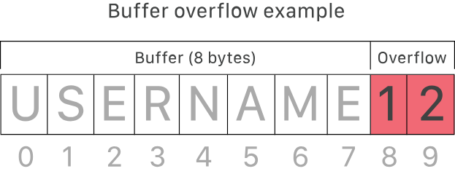
Buffer Overflow
Buffer overflow is an anomaly that occurs when software writing data to a buffer overflows the buffer’s capacity, resulting in adjacent memory locations being overwritten. In other words, too much information is being passed into a container that does not have enough space, and that information ends up replacing data in adjacent containers.
Buffer overflows can be exploited by attackers with a goal of modifying a computer’s memory in order to undermine or take control of program execution.

Slide 45
How Attackers Exploit Buffer Overflows
An attacker sends carefully crafted input to cause a buffer to overflow. This overwrites memory adjacent to the buffer, allowing the attacker to:
Replace executable code with malicious code
Change memory pointers to point to exploit payloads
Gain complete control over the program
Real-World Impact:
In 2014, the "Heartbleed" vulnerability exposed hundreds of millions of users by exploiting a buffer overflow in SSL software.
Vulnerability by Language:
C and C++ - HIGH RISK (no built-in memory protections)
Java, PERL, C# - LOWER RISK (have built-in protections)

Slide 46
Protection & Types of Attacks
How to Protect:
1. Address Space Randomization (ASLR)
  Randomly rearranges memory locations so attackers cannot predict code locations
2. Data Execution Prevention (DEP)
  Marks memory areas as executable or non-executable, blocking malicious code execution
3. Secure Coding & Patching
  Use languages with built-in protections
  Apply security patches immediately
Common Attack Types:
Stack Overflow - Most common; overflows buffer on call stack
Heap Overflow - Targets open memory pool data
Integer Overflow - Arithmetic operation creates number too large for its type
Unicode Overflow - Unicode characters are larger than ASCII, causing overflow

Slide 47
Reliability Testing
Software reliability is very important in all fields (business, military, etc.).
Modern software depend heavily on reliable software.
User expect failure-free software under a specified environment and for a specific period of time.
Software reliability testing is the method to uncover those failures earlier, which are most likely to appear in actual operation.
Consequently, important bugs are fixed, thereby increasing the reliability of the software.
Objectives:
The primary purpose of executing reliability testing is to test the performance of a software under some given conditions.
Secondary objectives are:
It may be the case that a failure is being repeated several times. So the objective is to find perceptual structure of repeating failures and the reason.

Slide 48
Reliability Testing (cont.)
To find the mean life of a software.
To find the number of failures in a specified period of time.
To measure software reliability, two matrices are used: Mean Time to Failure (MTTF), that is, the difference between two consecutive failures
And Mean Time to Repair (MTTR), that is, the time required to fix the failure.
Types:
Feature Test: The purpose is to ensure that each functionality of all the modules in the software and their interfaces are tested.
Regression Test: The purpose is to re-check the software functionality whenever there is a change in it.
Load Test: The purpose is to check the software under maximum load put on every aspect and even beyond that (i.e., to check the reliability of the software under maximum load and breakdown).

Slide 49
What is penetration testing?
Penetration testing (or pen testing) is a security exercise where a cyber-security expert attempts to find and exploit vulnerabilities in a computer system. The purpose of this simulated attack is to identify any weak spots in a system’s defenses which attackers could take advantage of.
This is like a bank hiring someone to dress as a robber and try to break into their building and gain access to the vault. If the ‘robber’ succeeds and gets into the bank or the vault, the bank will gain valuable information on how they need to tighten their security measures.
Why is penetration testing important?
Penetration testing helps an organization discover vulnerabilities and flaws in their systems that they might not have otherwise been able to find. This can help stop attacks before they start, as organizations can fix these vulnerabilities once they have been identified.

Slide 50
What are the types of pen tests?
Open-box pen test - In an open-box test, the hacker will be provided with some information ahead of time regarding the target company’s security info.
Closed-box pen test - Also known as a ‘single-blind’ test, this is one where the hacker is given no background information besides the name of the target company.
Covert pen test - Also known as a ‘double-blind’ pen test, this is a situation where almost no one in the company is aware that the pen test is happening, including the IT and security professionals who will be responding to the attack. For covert tests, it is especially important for the hacker to have the scope and other details of the test in writing beforehand to avoid any problems with law enforcement.
External pen test - In an external test, the ethical hacker goes up against the company’s external-facing technology, such as their website and external network servers. In some cases, the hacker may not even be allowed to enter the company’s building. This can mean conducting the attack from a remote location or carrying out the test from a truck or van parked nearby.
Internal pen test - In an internal test, the ethical hacker performs the test from the company’s internal network. This kind of test is useful in determining how much damage a disgruntled employee can cause from behind the company’s firewall.

Slide 51
Software penetration testing
Most commonly used today
Currently
  Outside->in approach
  Better to do after code review and ARA
  As part of final preparation acceptance regimen
  One major limitation
    Almost always a too-little-too-late attempt at the end of a development cycle
      Fixing things at this stage
        May be very expensive
        Reactive and defensive
Notes:
51

Slide 52
Software penetration testing
A better approach
  Penetration testing from the beginning and throughout the life cycle
  Penetration test should be driven by perceived risk
  Best suited for finding configuration problems and other environmental factors
  Make use of tools
    Takes care of majority of grunt work
    Tool output lends itself to metrics
    Tools for penetration testing
      fault injection tools;
      attacker’s toolkit: disassemblers and decompilers; coverage tools monitors
Notes:
52

Slide 53
Risk based security testing
Testing must be
  Risk-based
  grounded in both the system’s architectural reality and the attacker’s mindset
    Better than classical black box testing
  Different from penetration testing
    Level of approach
    Timing of testing
      Penetration testing is primarily on completed software in operating environment; outside->in
Notes:
53

Slide 54
Risk based security testing
Security testing
  Should start at feature or component/unit level testing
  Must involve two diverse approaches
    Functional security testing
      Testing security mechanisms to ensure that their functionality is properly implemented
    Adversarial security testing
      Performing risk-based security testing motivated by understanding and simulating the attacker’s approach
Notes:
54

Slide 55
Abuse cases
Creating anti-requirements
  Important to think about
    Things that you don’t want your software to do
    Requires: security analysis + requirement analysis
  Anti-requirements
    Provide insight into how a malicious user, attacker, thrill seeker, competitor can abuse your system
    Considered throughout the lifecyle
      indicate what happens when a required security function is not included
Notes:
55

Slide 56
Abuse cases
Abuse cases in software security define how attackers intentionally misuse, exploit, or bypass system features to cause harm, such as data theft, fraud, or service disruption. Unlike functional use cases, they model negative scenarios—"what can go wrong"—to drive security requirements and build defensive countermeasures.
Notes:
56

Slide 57
Abuse cases
Creating an attack model
  Based on known attacks and attack types
  Do the following
    Select attack patterns relevant to your system – build abuse case around the attack patterns
    Include anyone who can gain access to the system because threats must encompass all potential sources
  Also need to model attacker
Notes:
57

Slide 58
Common Abuse Case Examples
Authentication Bypass: Using "forgot password" features for unauthorized account access, or brute-forcing credentials.
API Abuse: Manipulating API endpoints to steal data or disrupt services.
Input Manipulation: Using SQL injection or Cross-Site Scripting (XSS) to inject malicious code through input fields.
Resource Exhaustion: Flooding a system with requests to cause denial of service.
Logic Flaws: Exploiting business workflows, such as manipulating shopping cart totals or skipping validation steps.

Slide 59
How to Implement Abuse Cases
Think Like an Attacker: Identify how a user might interact with the system in unintended ways.
Model Scenarios: Create scenarios for every major feature, focusing on the "what if" a malicious actor interacts with it.
Define Security Controls: Implement input validation, authentication, and monitoring to stop the abuse.
Test and Validate: Use automation and manual testing to confirm that the system correctly handles malicious input.

Slide 60
Security requirements and operations
Security requirements
  Difficult tasks
  Should cover both over functional security and emergent characteristics
    Use requirements engineering approach
Security operations
  Integrate the security operations
    e.g. software security should be integrated with network security
Notes:
60

Slide 61
Research Motivations
Absence of Data-set: So we are in need of an efficient data-set for analyzing Intrusion Detection Systems.
Machine-Learning Techniques will improve the security by around 200%.
Marking threats according to their effect on vulnerability is needed to draw architecture for software security.
All Viruses, Trojans and Malwares should be studied and handled carefully to make our system strong enough against these, in real- time.
Notes:
61

Slide 62
Latent Errors: How Many Errors are Still Remaining?
Make a few arbitrary changes to the program:
  Artificial errors are seeded into the program.
  Check how many of the seeded errors are detected during testing.

Slide 63
Error Seeding
Let:
  N be the total number of errors in the system
  n of these errors be found by testing.
  S be the total number of seeded errors,
  s of the seeded errors be found during testing.

Slide 64
Error Seeding
n/N = s/S
N = S n/s
Remaining defects:
N - n = n ((S - s)/ s)

Slide 65
Quiz 2
100 errors were introduced.
90 of these errors were found during testing
50 other errors were also found.
Find errors remaining in code.

Slide 66
Quiz 2: Solution
100 errors were introduced.
90 of these errors were found during testing
50 other errors were also found.
Remaining errors=
50 (100-90)/90 = 6

Slide 67
Challenges in Error Seeding
The kinds of seeded errors should match closely with existing errors:
  However, it is difficult to predict the types of errors that exist.
Categories of remaining errors:
  can be estimated by analyzing historical data from similar projects.

Slide 68
Quiz 3
Before system testing 100 errors were seeded.
During system testing 90 of these were detected.
150 other errors were also detected
How many unknown errors remain after system testing?

Slide 69
Summary
Discussed security testing in detail.
Discussed Types of Security Requirements
Explained Software Vulnerability.
Presented the Elements of Security Testing.
Discussed the Security problems in software and the solution.
Discussed how to know the latent errors.

Slide 70
References
Rajib Mall, Fundamentals of Software Engineering, (Chapter – 10), Fifth Edition, PHI Learning Pvt. Ltd., 2018.
Naresh Chauhan, Software Testing: Principles and Practices, (Chapter – 7), Second Edition, Oxford University Press, 2016.

Slide 71
THANK YOU

